Slide 1
Final Figure Drawing Project!

Slide 2
Requirements
Write these in your sketchbook!
Include at least one PROPORTIONAL full-bodied figure.
Use at least one figure you explored in class. Either one from live figure drawing or the magazine picture you drew in your sketchbook.
3. Use any drawing material(s) of your choice: pencil, charcoal, pens, colored pencils, markers, oil pastel, or chalk pastels

Slide 3
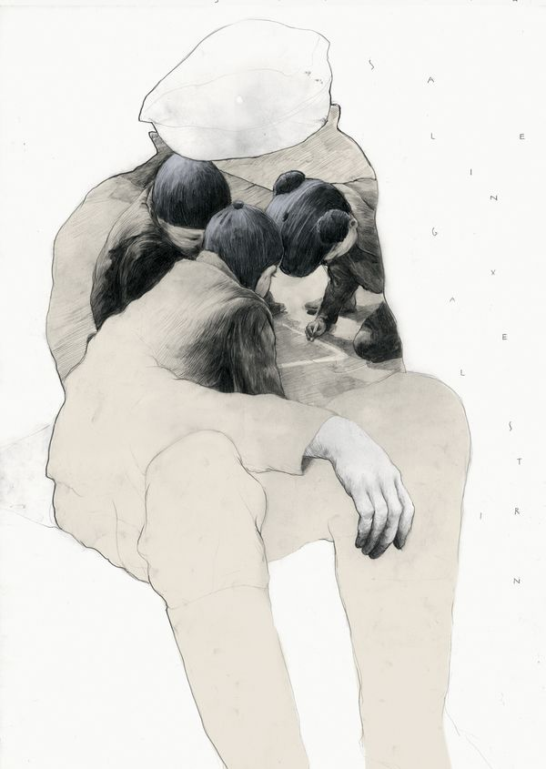
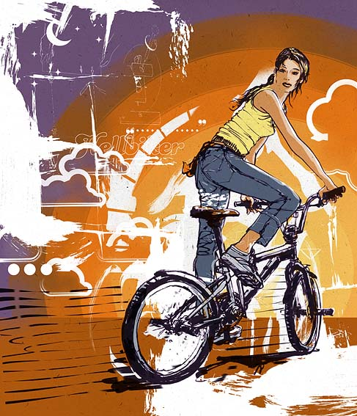

Slide 4
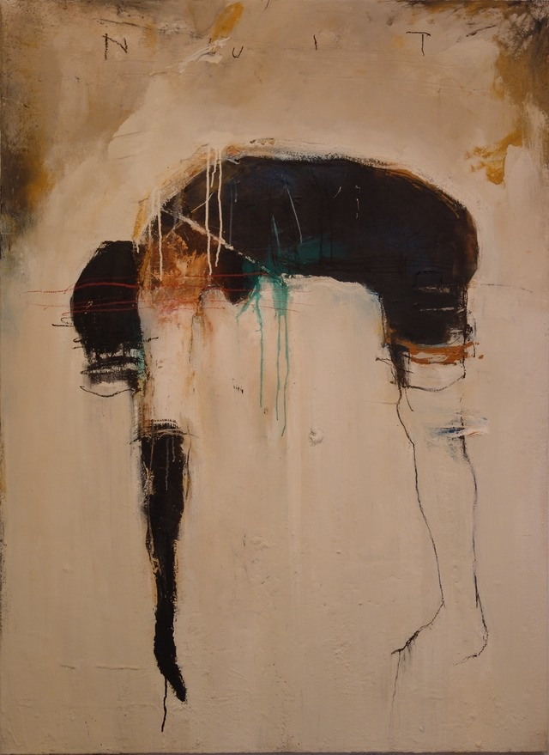
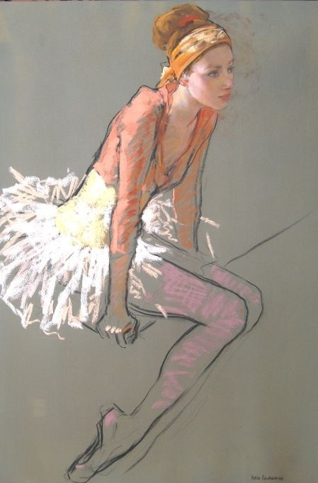

Slide 5
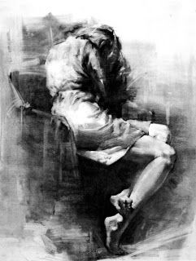

Slide 6
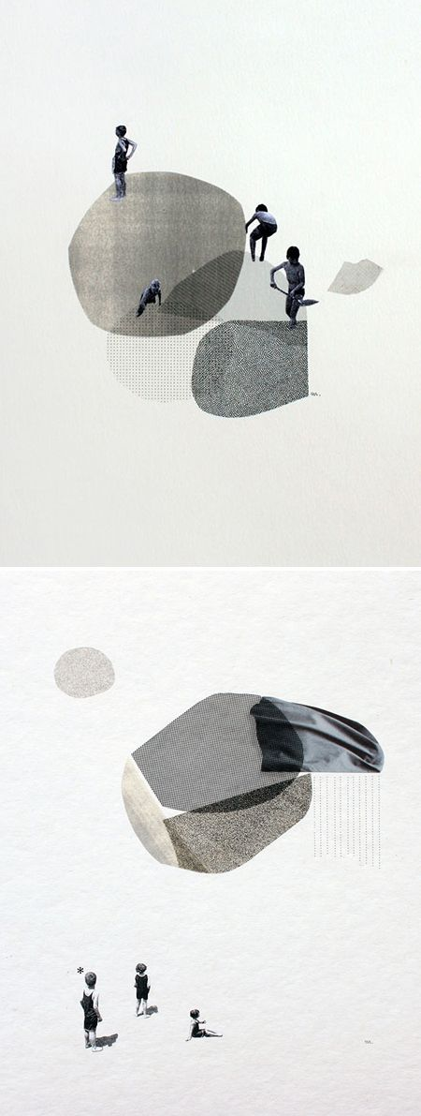
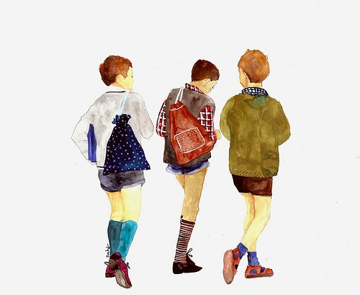

Slide 7
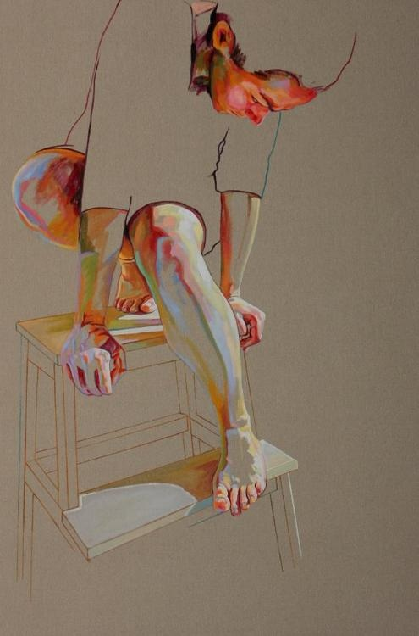

Slide 8
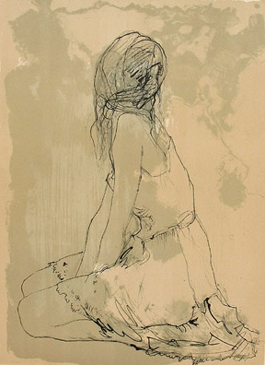

Slide 9
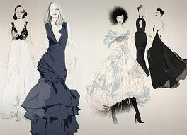
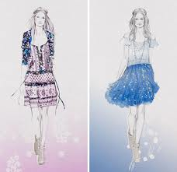

Slide 10
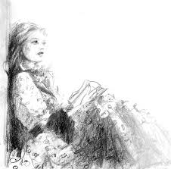
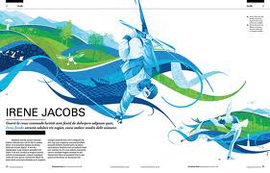

Slide 11
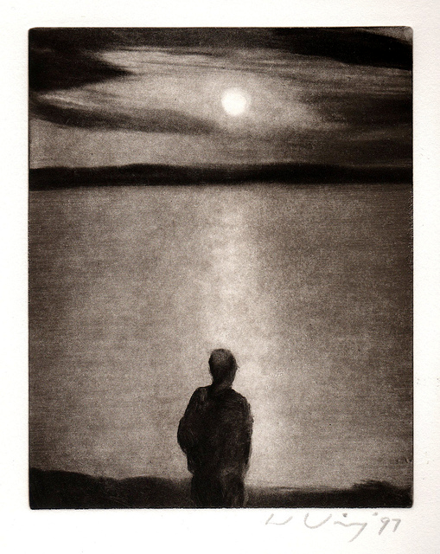
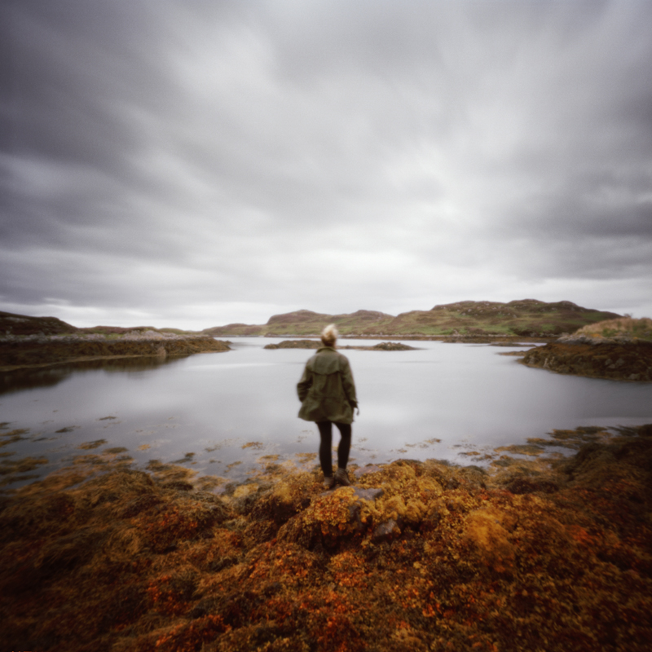

Slide 12
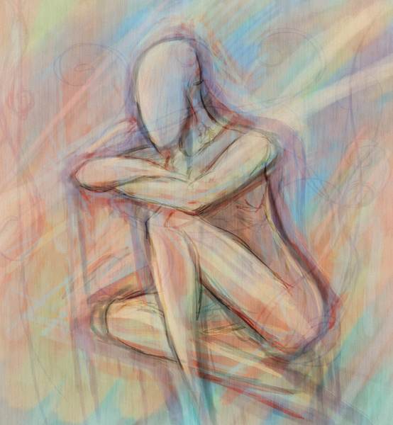
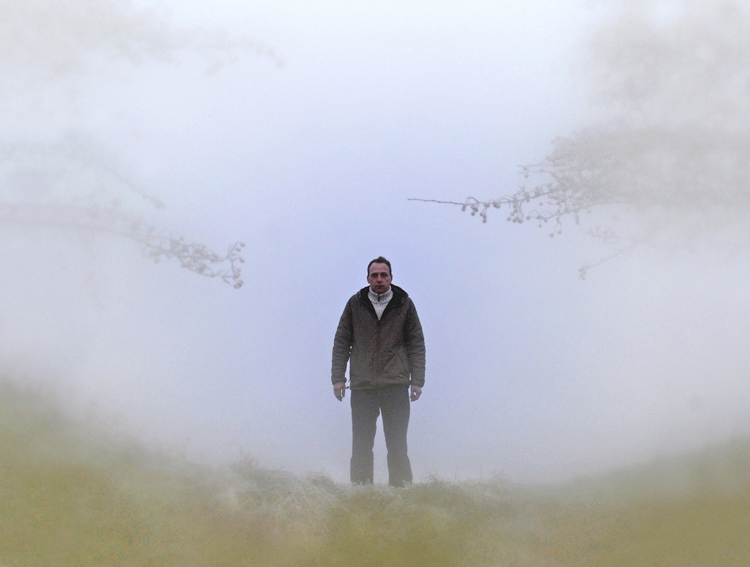

Slide 13
Now answer these in your sketchbook…Then draw at least three thumbnail sketches of your composition.
1. Look through all of your figure drawings. Which ones are the best drawn? What one or ones do you want to use in your final drawing?
2. What style of drawing are you going to draw this in? Abstract? Whimsical? Realistic? Zentangle? Surreal? Ect…
3. Is your image going to tell a story? Display a mood or emotion? Simply show a proportionate and well drawn figure? What is your painting ABOUT?

