Slide 1
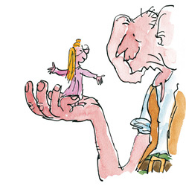
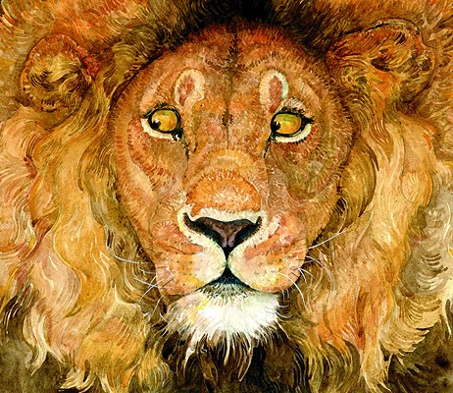
Imitating Illustrators!

Slide 2
What were some of your favorite books as a child? What do you remember about them? Share with your table!

Slide 3
What are we doing?
Picking two watercolor illustrators…
Writing about identifying their style…
You will imitate one of them!

Slide 4
Why are we doing this?
Who DOESN’T like illustrators?? They are eye-catching, familiar, fun, colorful, and full of expression and narrative!
If you are engaged with what you are painting you are more likely to produce a better painting and have more FUN!

Slide 5
Why are we doing this?
Be looking at all the watercolor techniques these artists use! You have already tried these techniques YOUR way and in your interpretation of them, now its time to try them a different way!
You get to apply what you have already learned!

Slide 6
Why are we doing this?
Painting in a different way gives you confidence in your abilities, and more freedom to try new techniques and processes in the future!
Seeing and practicing another artists style, may help you identify yours, and help you understand how to unify your works in the future.

Slide 7
Tim Burton
Filmwriter, artist, producer, poet, animator
Dark, quirky, horrific fantasy
“Nightmare Before Christmas”
“Beetlejuice”
“Sleepy Hollow”
“Corpse Bride”
“Edward Scissorhands”
“Frankenweenie”
“Charlie and the Chocolate Factory”
“Alice in Wonderland”
His mom owned a cat-themed gift shop…WEIRD!
Wasn’t a very good student, but loved his art classes!
Loved Dr. Suess! Inspired by him!

Slide 8
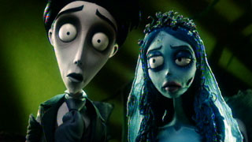

Slide 9
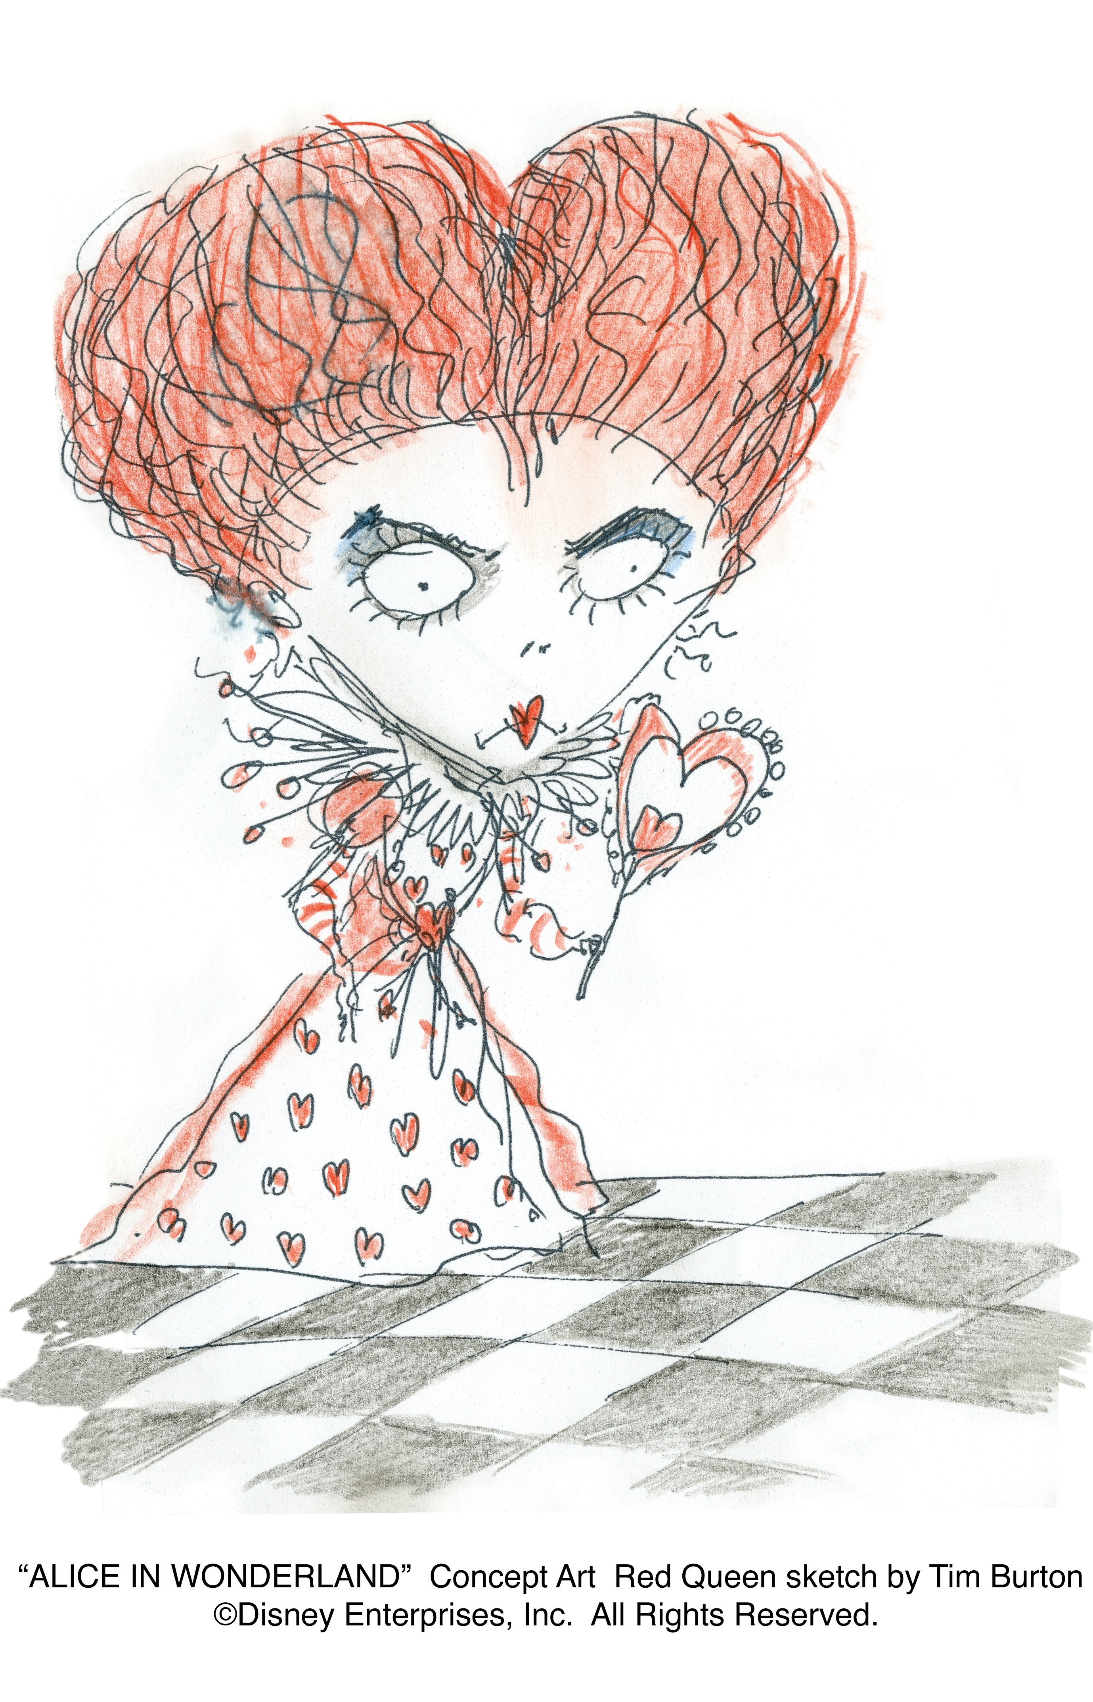

Slide 11
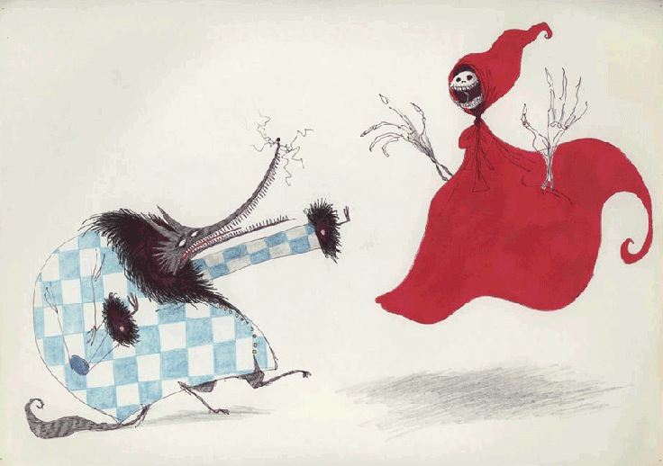

Slide 13
Discuss, write down, and then be prepared to share with the group please! ☺

Slide 14
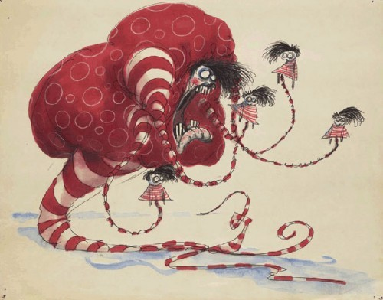
How does this illustrator show emotion, time of day, a narrative, and mood, ect?

Slide 15
What identifies this illustrator’s artistic style? (Hint: Think about the elements and principles of design and how they use these!)

Slide 16
How did this illustrator exaggerate elements from life?
How do these exaggerations aid in the style of the artist and their intended meaning of the image?

Slide 17
Now that you have practiced answering these questions, find two watercolor illustrators and answer the same questions about them! Put these answers in your sketchbook…I will come around and check your answers! These are tools for you when imitating!

Slide 18
Inquiries About Your Illustrator
Your name: ______________________
Illustrators name: _________________
1.) What watercolors techniques does this illustrator use?
2.) How does this illustrator show emotion, time of day, a narrative, and mood?
3.) How does this illustrator exaggerate elements from life? How do these exaggerations aid in the style of the artist and their intended meaning of the image?
4.) What identifies this illustrator’s artistic style? (Hint: Think about the elements and principles of design and how they use these!)

