Slide 1
Letter Paintings!

Slide 2
Lets Watch a Creative Alphabet!
http://www.youtube.com/watch?v=8FPG-R6m5Ss
Why did we watch that video?
How did they make these letters different
and special?

Slide 3
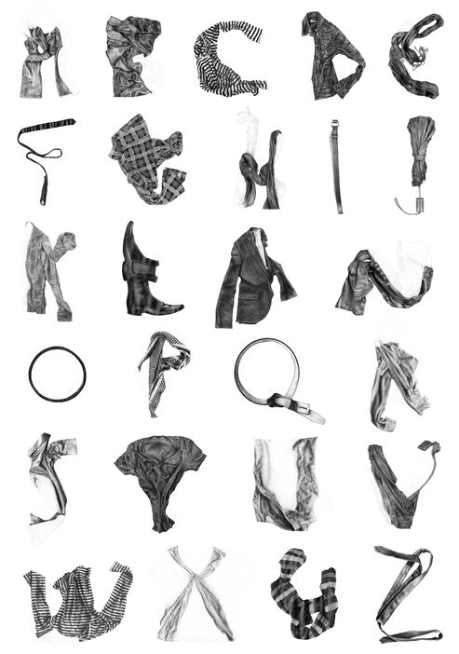
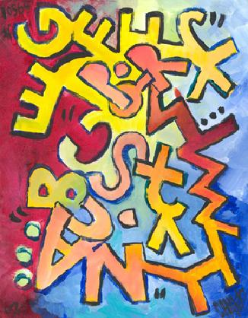

Slide 4
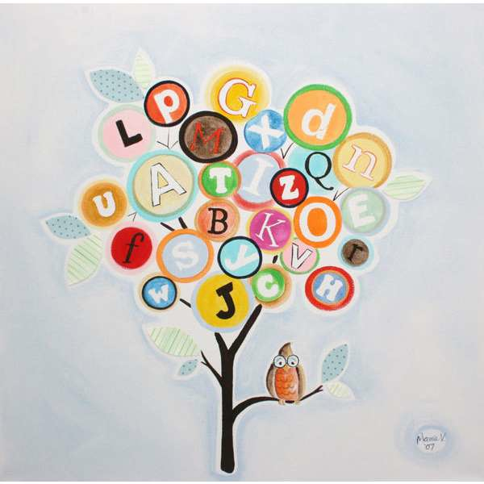
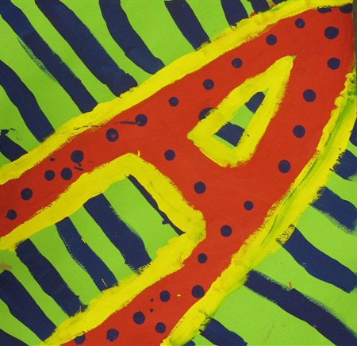

Slide 5
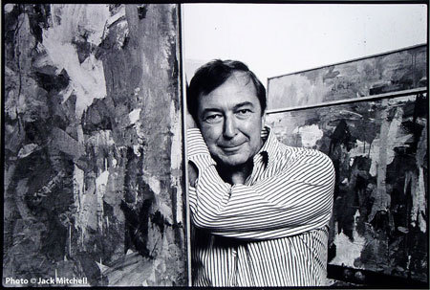
Jasper Johns
Painter just like YOU!
Stenciled words, numbers, letters

Slide 6
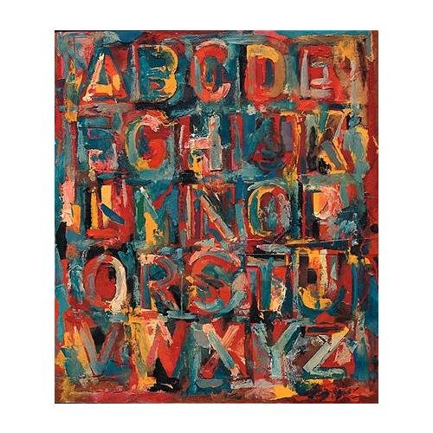
“Colored
Alphabet”
What do
you see?
How did he
make this
special and
interesting?

Slide 7
Learning Targets!
I can make a painting of the whole alphabet or the first letter of my name with oil pastels and watercolor.
I can create my letter(s) painting by drawing my letters with oil pastels and mixing watercolor colors for the background.

Slide 8
