Slide 1
Painted Objects

Slide 2
Think, pair, share!
Do you have any painted objects in your house? What are they?
Do you enjoy painting on objects? Have you ever done it before? Maybe as a child?

Slide 3
What are we doing and why?
Painting on any 3-D object of your choice!
Painting with acrylics or watercolors! (may use some mixed media drawing materials at the end…)
Why? Challenges you to paint on an unusual surface and gets you to think more about what else a painting could be!

Slide 4
YOU are going to create your own purpose and meaning behind the painting you produce, on the specific object(s) you have chosen…
Here are some examples of what you could produce…

Slide 5
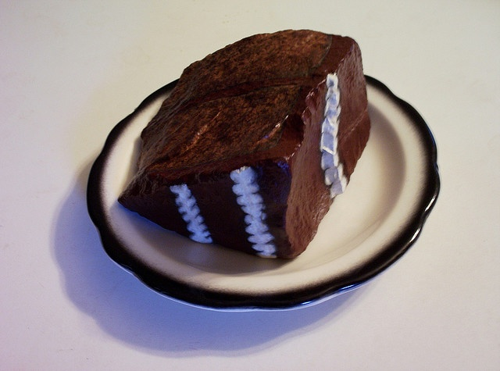
Observe the what shape and form of the object is and that becomes your painting and object!

Slide 6
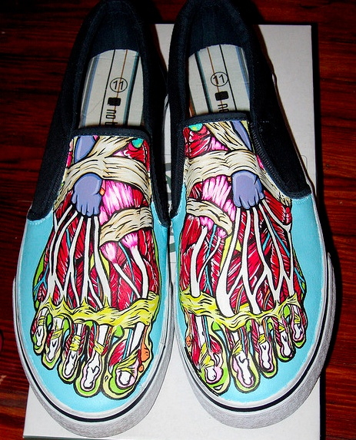
Determine what the object is used for and your painting relates to its use!

Slide 7
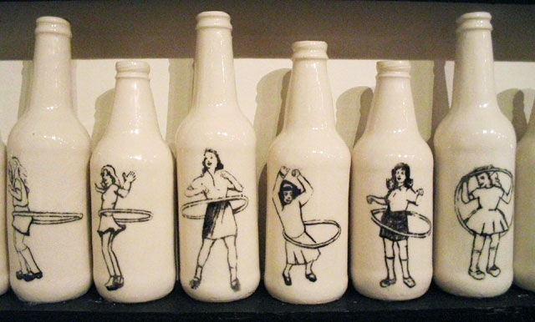
Your painting doesn’t relate to your object, but there is a reason why you painted it.
Ex: The colors and patterns represent a certain emotion
Ex: The images painted represent a memory

Slide 8
Let us PINTEREST!

